Slide 1


P4 PROGRAMMING
-By BURHANUDDIN RANGWALA
-BY MOHAMMAD AMIN SHAIKH

Slide 2

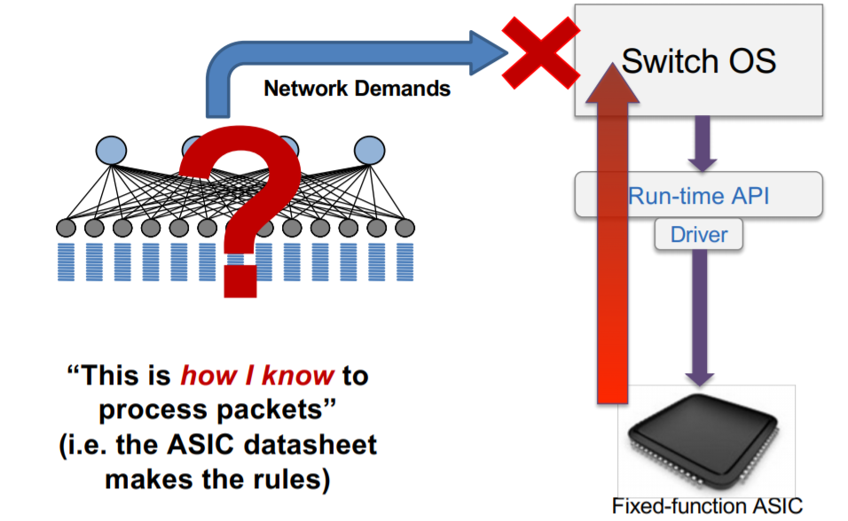



WHY THE NEED FOR PROGRAMMABLE DATA PLANE?

Slide 3
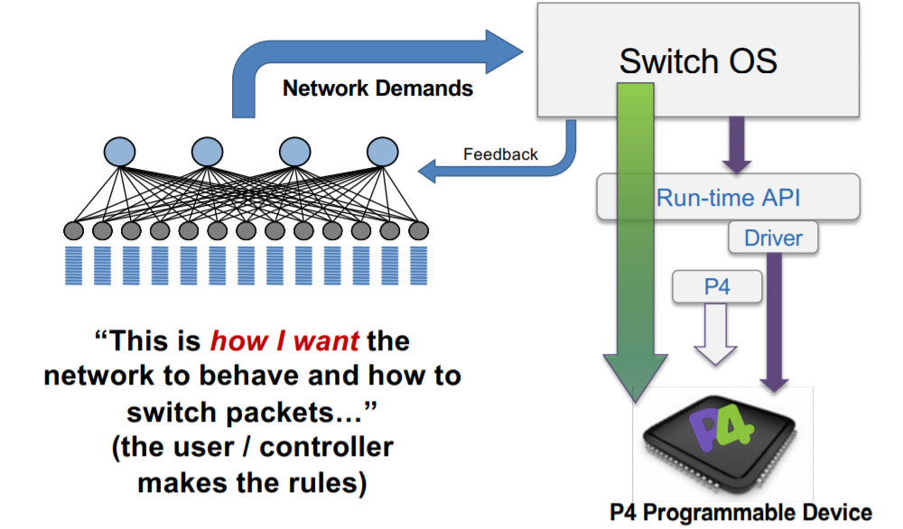
WHAT IS PROGRAMMABLE DATA PLANE?

Slide 4
P4 is abbreviation for Protocol Independent Packet Processor. P4 is used to program data planes only and provides interface for communication between control plane and data plane. It helps us achieve our goal of instructing the switch to process packets satisfying our requirements, making the network malleable. P4 has provided a breakthrough in customizing the network, creating a customizable environments catering to our creativity in providing best networking services. Target manufacturers provide the hardware or software implementation framework, an architecture definition, and a P4 compiler for the target.
P4

Slide 5
P4 GOALS
Reconfigurability in the field
reprogramming of networking equipment Protocol independence
Protocol independence
not tied to any specific networking protocols
Target independence
not tied to any specific networking hardware

Slide 6
APPLICATIONS
Layer 4 Load Balancer
Low Latency Congestion Control
In Band Network Telemetry
Consensus at network speed
Fast In-network cache for key-value stores

Slide 7
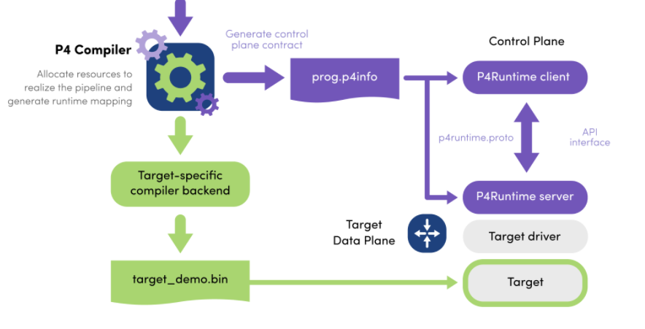
P4 WORKFLOW

Slide 8
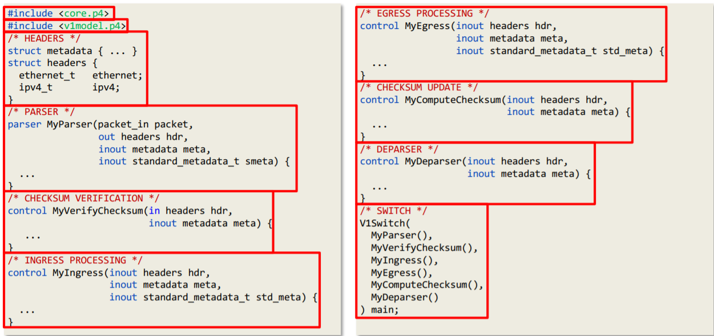
P4 PROGRAM TEMPLATE

Slide 9
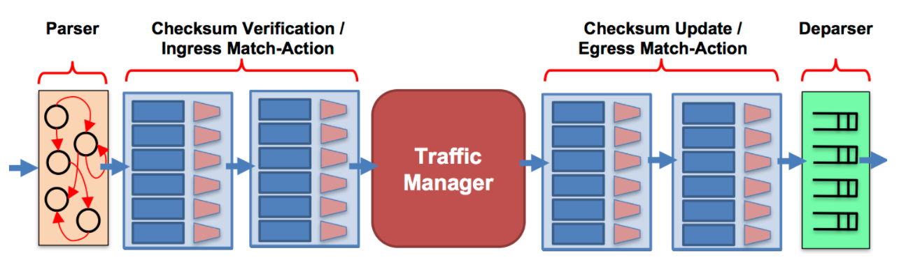
BMV2 SWITCH
Behavioral model is a software switch designed to act as target for our P4 program.
It is configured using JSON configuration file written by programmer.
It follows V1 model architecture as shown below.

Slide 10
DEMO TIME!!

